Slide 1

The Mobile Communications Sector within the Greek Economy and Society

Slide 2
The Greek economic environment and the consequences of recession
The general state of recession has directly affected the mobile telephony sector, resulting in a faster rate of revenues decrease than the rate of GDP decrease

Slide 3
Sector Results and Indexes – Mobile Telephony Revenues
The 2013 Sector’s service revenues have decreased to 2086 mil. euro, down by 52% since 2007
  In the past 5 years, annual revenue decreases in Greece were in the double digits in contrast to the rest of Europe were decreases have been under 5% annually
  Revenues have been negatively affected by the economic crisis, the regulatory interventions and over taxation of mobile com. services
  Approximately half of the service revenues reduction in 2013 is due to the reduction of termination tariffs
  Source: Analysis of data from Mobile Telephony Operators

Slide 4
Sector Results and Indexes – Mobile Telephony Revenues
Τhe Sector’s 2013 EBITDA have decreased to 1056 mil. euro, down by 39% since 2008
  The tariff decrease due to competition and regulatory intervention has contracted the Sector’s earnings
  The Sector’s EBITDA margin has increased during the last few years as the Operators have contained expenses
  Source: Analysis of data from Mobile Telephony Operators

Slide 5
Sector Results and Indexes – Call minutes
In 2013, total call minutes increased slightly (1,8%) but call minutes per user decreased (-3,4%)
  For the first time in 2012 and 2013 the call minutes per user (MOU) showed a decrease due to the negative impact of the financial crisis on demand. The large increase between 2009 – 2011 was due to the reduction of the number of users following the obligatory registration of card users.
  Total call minutes increased in 2013, following a decrease in 2012 and 2011, as the number of subscribers increased.
  Source: Analysis of data from Mobile Telephony Operators

Slide 6
Sector Results and Indexes – Revenue per user (ARPU)
In 2013, revenue per user (ARPU) in Greece decreased by 22% to 10.8€ ; at far lower levels than the rest of Europe
  While up to 2006 the ARPU in Greece and Europe were at the same level, in the following years the ARPU in Greece decreased steeply and fell well below the European
  The lower tariff per call minute and the lower data penetration in Greece relatively to Europe have a negative impact on this index

Slide 7
Sector Results and Indexes – 1st Q 2014
In Q1 2014, the rate of decrease in service revenue is -7,3%, which is the least severe of the past two years.
  The Sector continues to be in a more profound recession than the whole economy, as regulatory interventions, over taxation and competition put pressure on its revenues.
  Termination tariffs decreased further as of 1/1/2014, but the decrease is smaller than that of the previous year.
  Contrary to the Sector’s revenues, EBITDA show a milder decrease due to strict control over expenses
  The Sector continues to invest in the economy with own capital of up to €70 mil. per quarter, increasing by 20,6% y/y
  Source: Analysis of data from Mobile Telephony Operators

Slide 8

Sector’s contribution in the Greek Economy

Slide 9
Sector Results and Indexes – Investments
In 2013, the Sector invested 255 mil. Euro in Greece and €7 billion since the beginning of its operation, thus significantly contributing in the development and technological upgrading of the country
  Investments were funded by own capital due to the inability of the banks to finance the Operators through loans.
  The expected decrease in revenues and EBITDA in the coming years will limit the ability of the Operators to finance the investments that are necessary for network upgrading
  Source: Analysis of data from Mobile Telephony Operators

Slide 10
The Sector’s contribution to the GDP
The Sector’s total contribution to the GDP within the last decade is 7% (excluding the 380 mil. of 2011). In a few months there will be more investment due to the auctioning of new spectrum for the 15 year licenses of the Mob. Operators
The Sector’s contribution is quite significant considering that the total growth of the Greek economy was 31.2% in the period 1992 - 2012
Estimated Sector Contribution in GDP (% in total)

Slide 11
The Sector’s contribution to Public Revenues
The Sector is one of the most significant partners of the Greek economy
EVOLUTION OF THE SECTOR’S CONTRIBUTION TO PUBLIC REVENUES
  Source: Analysis of data from the Operators, EL. STAT., Bank of Greece
  Source: Analysis of data from Mobile Telephony Operators

Slide 12
The Sector’s contribution to consumer- Price Reduction
NET PRICE PER CALL MINUTE - 2012
Presently Greece has the lowest prices of all other countries in West Europe, even after considering the additional burden to the consumer from the special mobile telephony tax.
  Source: European Telecoms Matrix Q1 2013, Merrill Lynch & Bank of America

Slide 13
The Sector’s contribution to Employment
CREATION OF DIRECT AND INDIRECT EMPLOYMENT BY THE SECTOR
  Source: Analysis of data from the Operator, EL. STAT.

Slide 14
The Sector’s contribution to Entrepreneurship
During its twenty year presence in the Greek market the Mobile Communications Sector has contributed significantly in the shaping of today’s business scene through the creation of:
New areas of business activity (eg industrial devices)
  It is estimates that sales of Apple's iPhone 5 accounted for 0.25% - 0.5% of U.S. GDP
New vertical activities in existing sectors (eg Mobile Advertising, M Health, M Education, Mobility - Social Networking)
  Facebook is expected to increase fivefold its revenues from mobile services and mobile advertising in the next year.
New markets such as the market of mobile applications, with a turnover of approximately €400 mil. In 2012 ($12 billion worldwide) and with an expected grow of 40% by 2017. The percentage of exports and investment in research and development surpass 80% and 25% of turnover, respectively.

Slide 15

The future of Mobile Communications and its contribution to growth

Slide 16
EE-Mobile Data Volume Growth
EUROPEAN SERVICE REVENUE SPLIT
Source: GSMA Mobile Economy 2013

Slide 17
EE-Mobile Data volume growth
MOBILE DATA VOLUME GROWTH
Source: GSMA Mobile Economy 2013

Slide 18
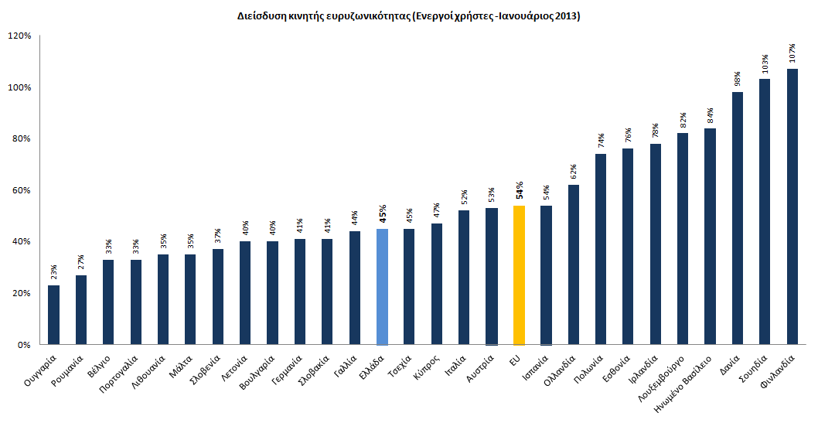
International Trends in Mobile Communications
Mobile BB
The Sector lags the average EU penetration in Mobile Broadband
  Mobile Broadband (Active Users-January 2013)
Source: Eurostat

Slide 19
Current Situation– Greece vs EE
The Sector lags the EU with respect to data service revenue - 16,2% (Greece) vs 31,6%. (EU)
  Data as % of Service Revenues (including SMS)
Source: European Telecoms Matrix Q1 2013, Merrill Lynch & Bank of America

Slide 20
Current Situation – Greece vs EE
The Sector lags in smart phone penetration and data transfer bundles!
Source: Vodafone Q1 2014

Slide 21
Growth upon conditions
The Mobile Communications Sector is one of the biggest and steadiest investors in the Greek economy, yet the hurdles to investment still persist
  The dysfunction of Public Administration hinders the Mob. Operators from realizing their investment plans:
High risk of loss of investment due to the inability of the Public Administration to license the Operators’ network investments within the time period that they are implemented.
Significant waste of resources on court adjudications and on fines which result from the untimely (overly delayed) licensing of the Operators’ network infrastructure.
Considerable delay by the Ministry of Infrastructure, Transport and Networks regarding the tabling of the draft Law which will improve the licensing procedure for mobile networks.
Significant delay in the issuance of Common Ministerial Decisions which are needed for the completion of the licensing framework.
  An unfavorable and inconsistent mobile telephony taxation framework:
The taxation of corporate mobile use as personal income should be abolished.
The Special Mobile Telephony Tax should be reexamined in order to reduce the telephone bill of the Greek consumer.

Slide 22
Reduction of the Special Mobile Telephony Tax
Greece is 1st in the EU and 4th worldwide respecting the analogy of taxes
The mobile telephony subscribers are burdened with total taxation of 36-48%.
At the EU level, total taxation does not exceed 25%.
  Government tax burden per country on mobile telecommunications in euro cents per minute (2013)
  Source: AT Kearney

Slide 23
Impact of Taxation Policy – Changes in the special mobile telephony tax, Public revenues and Recession
… the impact of the increase in the special mobile telephony tax along with the economic crisis result in lower Public revenues and lower usage of mobile telephony
In 2013 Public revenues decreased to levels lower than those of the period prior to the last increase in the special mobile telephony tax (2009).

